Slide 1

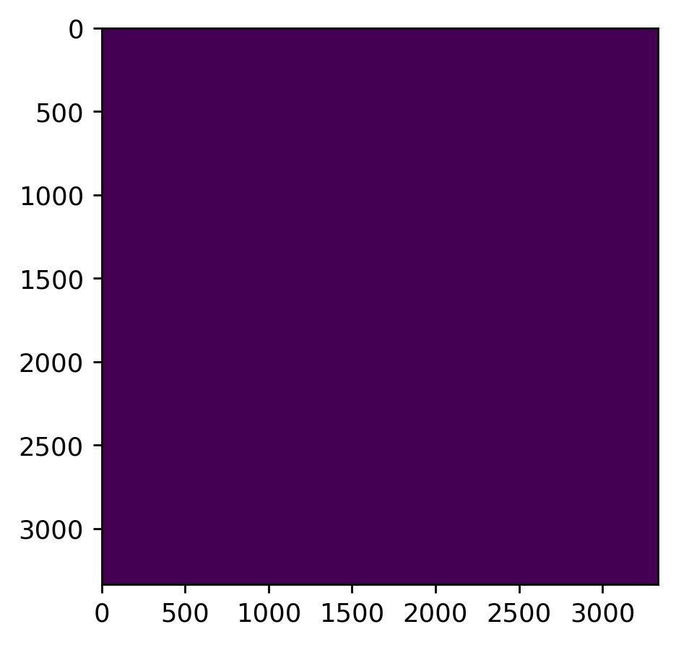
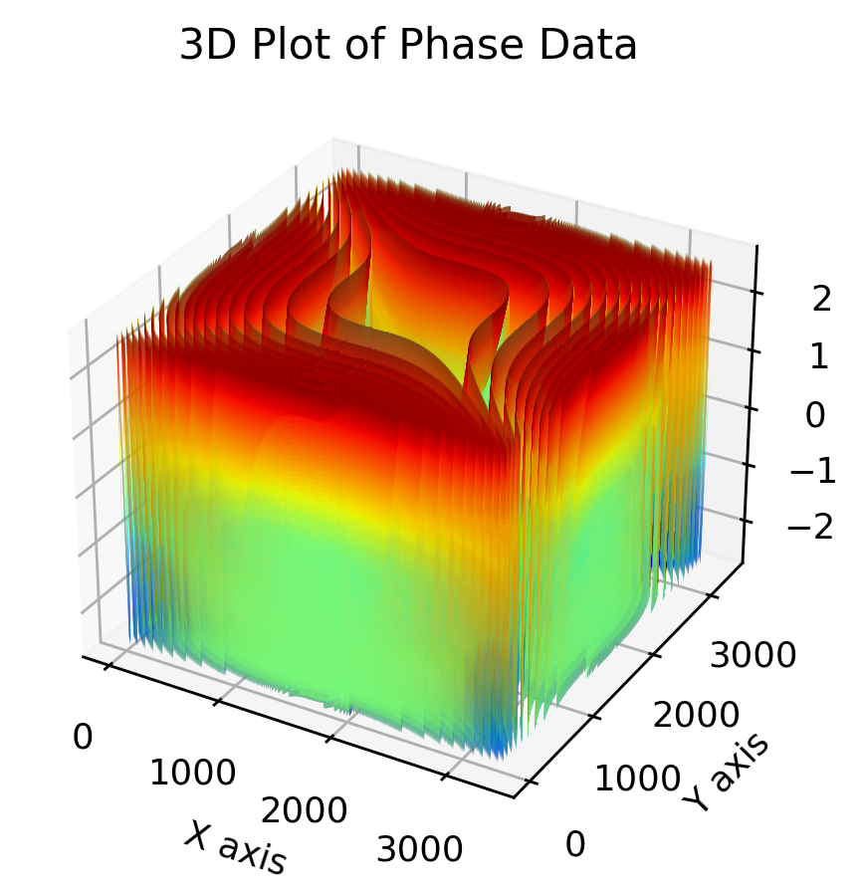
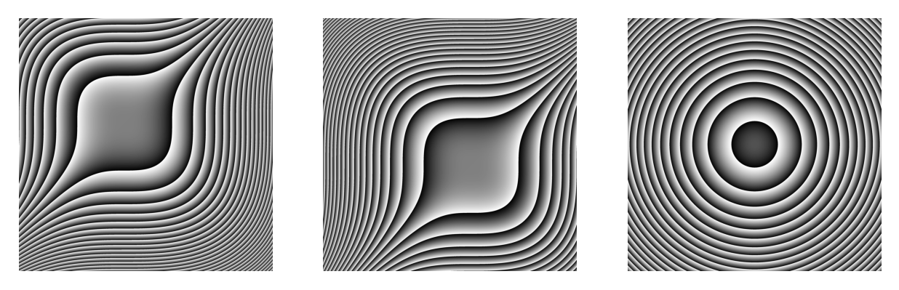

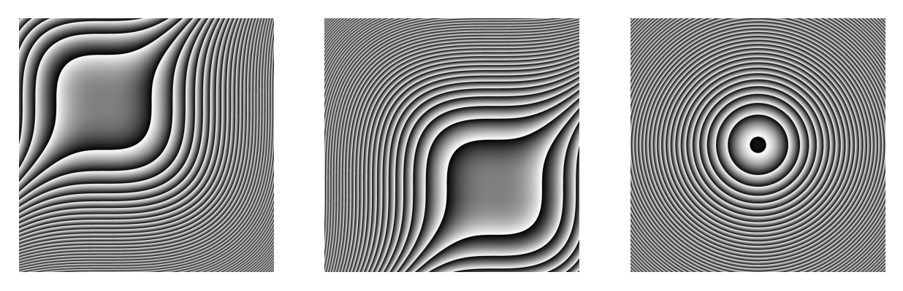
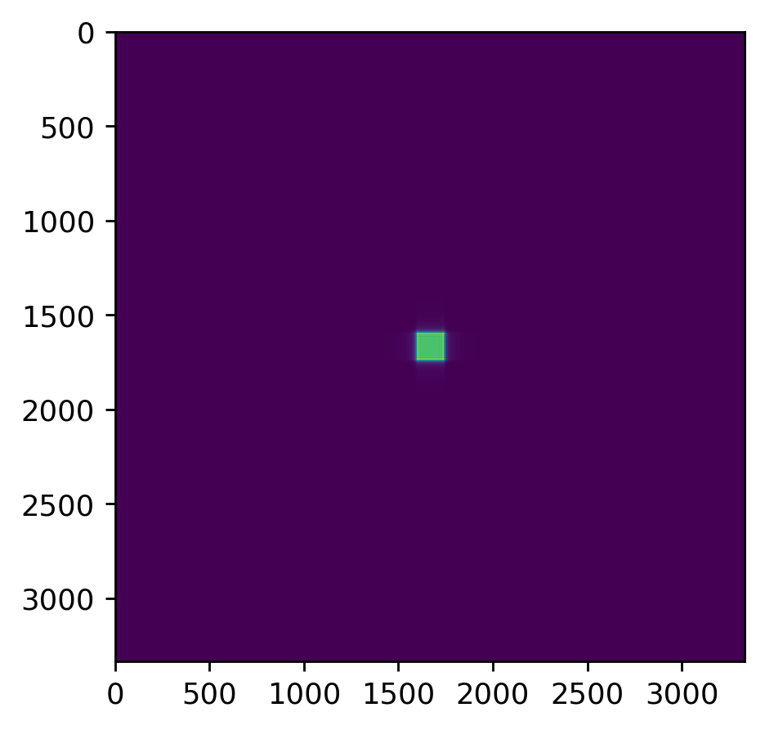
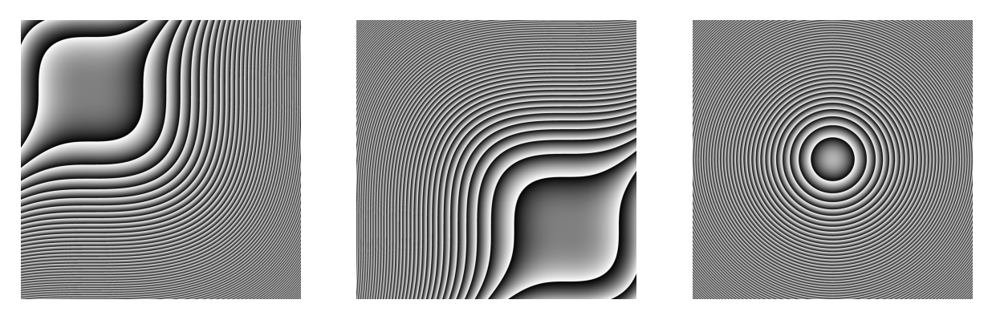

Increasing movement of parts(Both 1st & 2nd CPP)
Resolution : 3333 (Need discussion)
Size : 12mm
Pixel pitch : 3.6e-6 (May spec.)
C0 : 0.0193
Wavelength : 532nm
Refractive index of air : 1
Refractive index of medium : 1.456
Phase(CPP1)
Phase(CPP2)
Phase(pair)
PSF

Slide 2
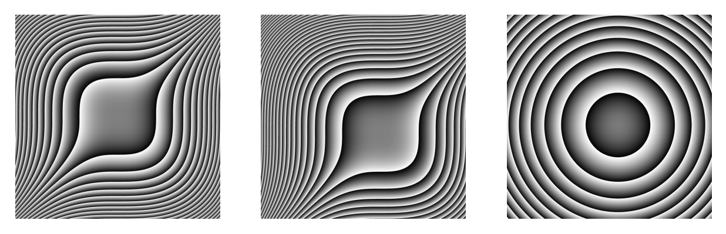

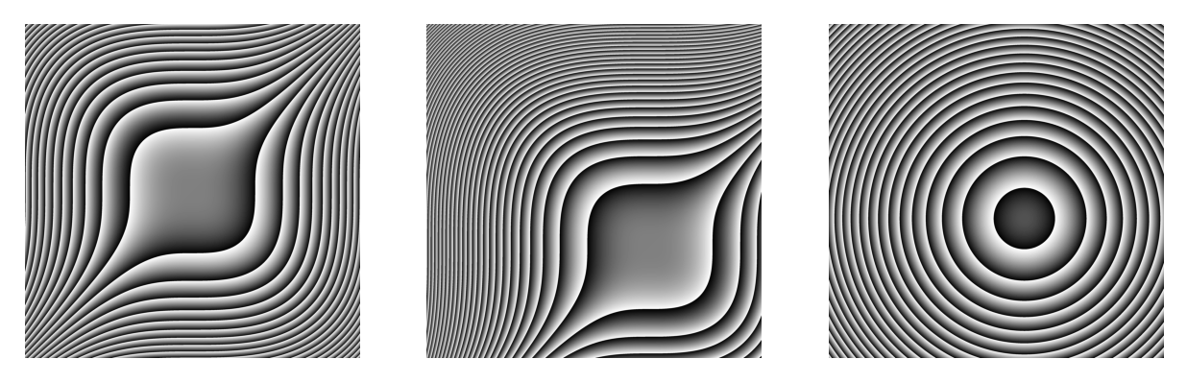

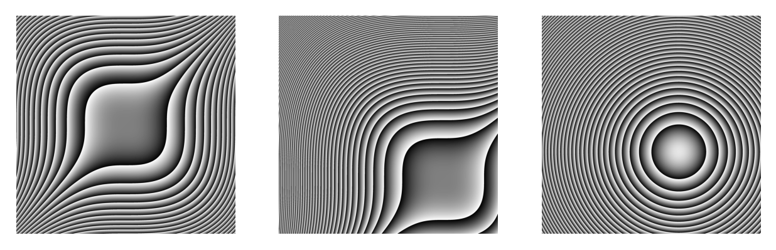

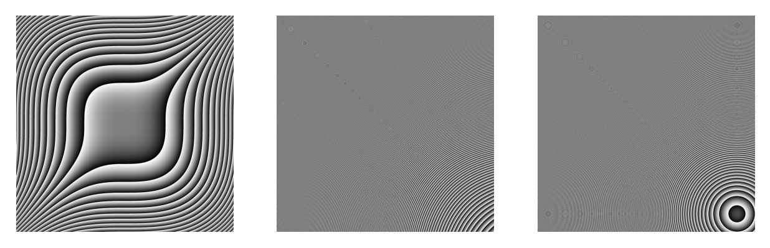
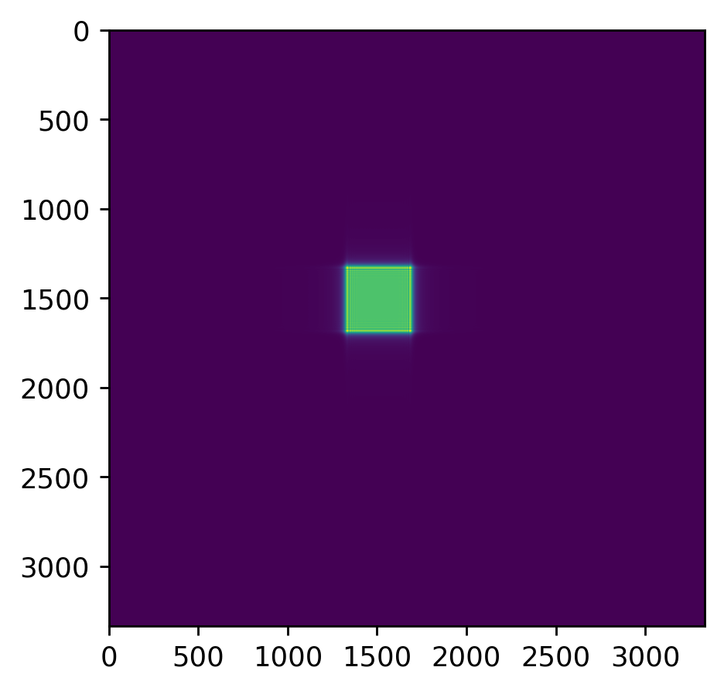
Increasing movement of parts(only 2nd CPP)
Resolution : 3333 (Need discussion)
Size : 12mm
Pixel pitch : 3.6e-6 (May spec.)
C0 : 0.0193
Wavelength : 532nm
Refractive index of air : 1
Refractive index of medium : 1.456
Phase(CPP1)
Phase(CPP2)
Phase(pair)
PSF

Slide 3
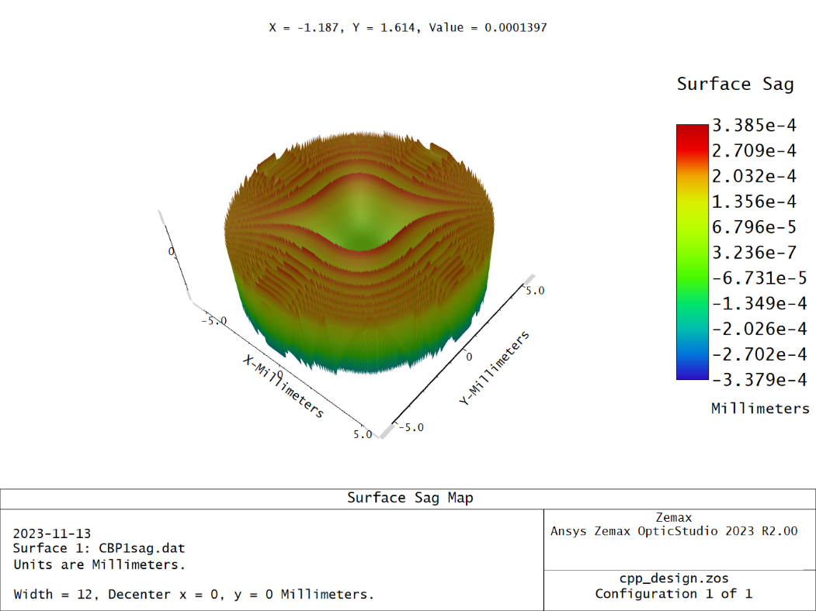
Zemax implementing(CPP1)

Slide 4
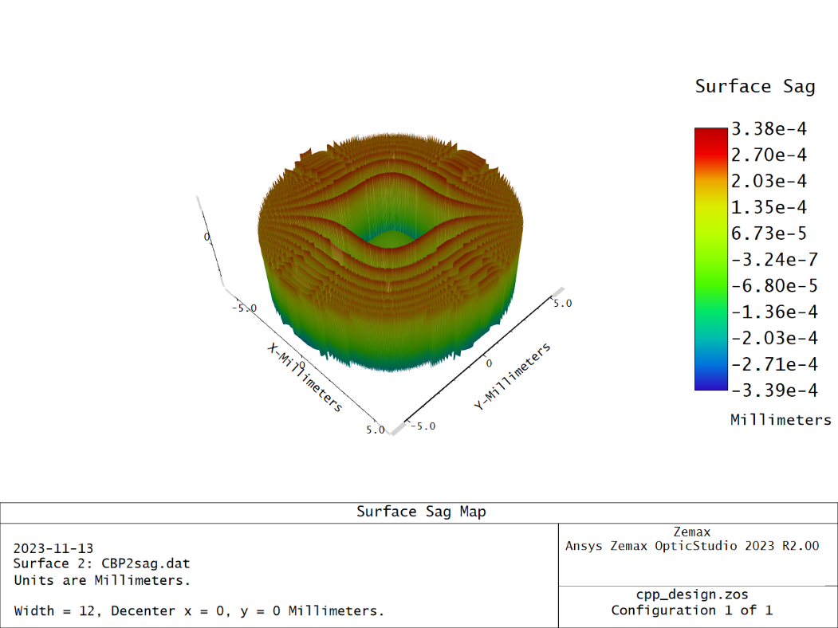
Zemax implementing(CPP2)

